Slide 1
SMU STAT-6336 Final Project
Insurance data analysis
December 6, 2022

Slide 2

Team Introduction
Hunter Schuler
Leon Yuan
First-Year PhD in Statistical Science at SMU
MS in Data Science at Vanderbilt University

Slide 3
Outline
Raw Data
Source
Structure
EDA
Graphics
Process
Modeling
Basic Linear
h2o auto-ML

Slide 4
Raw Data
Source: Kaggle (CC.0 1.0 License)
This data contains 7 columns and 1,338 rows
Attributes
Age
Sex
Response
Charges
BMI
Number of Children
Smoker
Region
No missing and undefined values

Slide 5
Explore Data Analysis
Three Categorical Attributes: sex, smoker, region

Slide 6
Explore Data Analysis
Three Categorical Attributes: sex, smoker, region

Slide 7
Explore Data Analysis
Three Categorical Attributes: sex, smoker, region

Slide 8
Explore Data Analysis
Four Continuous Attributes: age, bmi, children, charges

Slide 9
Explore Data Analysis
Four Continuous Attributes: age, bmi, children, charges

Slide 10
Explore Data Analysis
Four Continuous Attributes: age, bmi, children, charges

Slide 11
Explore Data Analysis
Four Continuous Attributes: age, bmi, children, charges

Slide 12
Explore Data Analysis
Four Continuous Attributes: age, bmi, children, charges

Slide 13
Explore Data Analysis
Correlation between Four Continuous Attributes: age, bmi, children, charges

Slide 14
Explore Data Analysis
Boxplot the relation between charges and sex

Slide 15
Explore Data Analysis
Boxplot the relation between charges and smoker

Slide 16
Explore Data Analysis
Boxplot the relation between charges and region

Slide 17
Modeling
Split the raw data without any preprocessing and rescaling stratified by smoker column.
Split
80%train
10%valid
10%test

Slide 18
Basic Linear Modeling
Train
Adj-R^2: 74%
RMSE: 6029
Valid
Adj-R^2: 73%
RMSE: 5521
Test
Adj-R^2: 73%
RMSE: 6671

Slide 19
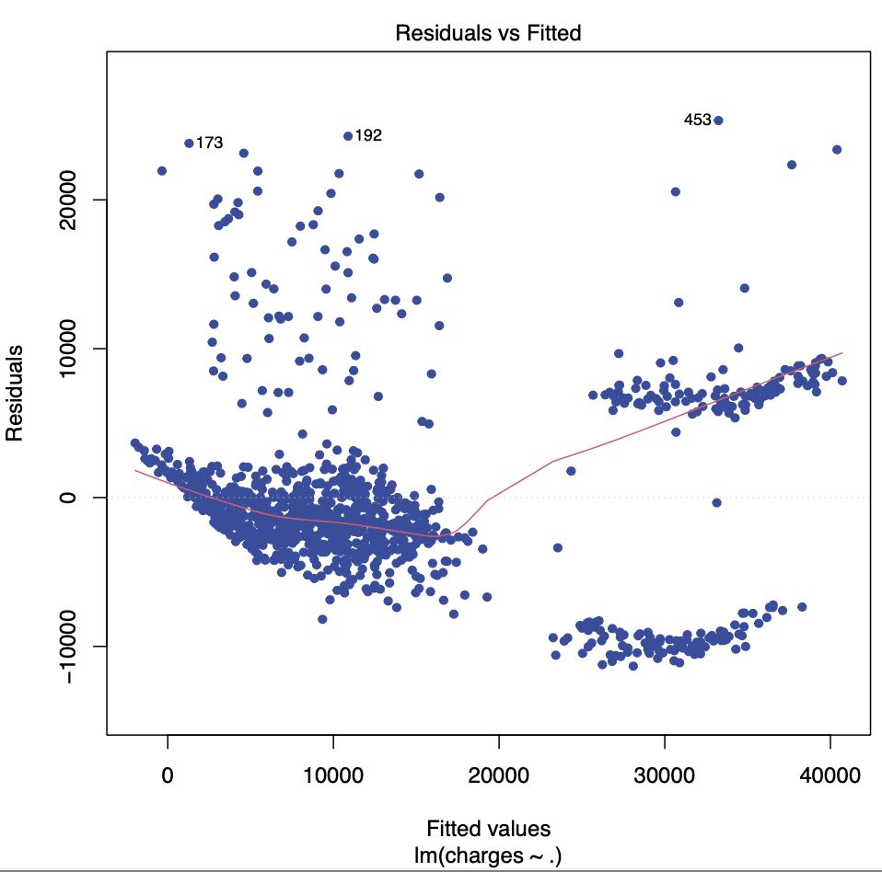
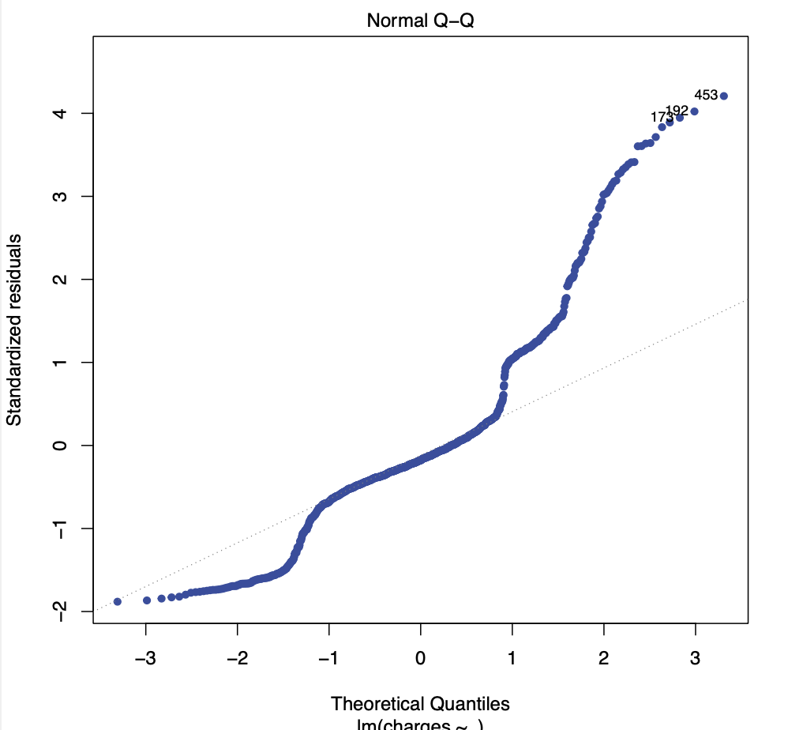
Basic Linear Modeling
Model Assumption Check Plots

